Slide 1
Database Management System (MDS 505)
Jagdish Bhatta
Jagdish Bhatta

Slide 2
Unit-2
The Relational Languages and Relational Model: Relational Model and Constraints
Jagdish Bhatta
Notes:
Jagidsh Bhatta

Slide 3
Relational Model
Relational model represents the database as a collection of relations where each relation resembles a table of values with rows and columns. Major advantages of relational model over the older data models are the simple data representation & the ways complex queries can be expressed easily.
When a relation is thought of as a table of values, each row in the table represents a collection of related data values. A row represents a fact that typically corresponds to a real-world entity or relationship. The table name and column names are used to help to interpret the meaning of the values in each row.
Jagdish Bhatta
Notes:
Jagidsh Bhatta

Slide 4
Relational Model
In the formal relational model terminology, a row is called a tuple, a column header is called an attribute, and the table is called a relation. The data type describing the types of values that can appear in each column is represented by a domain of possible values.
Jagdish Bhatta
Notes:
Jagidsh Bhatta

Slide 5
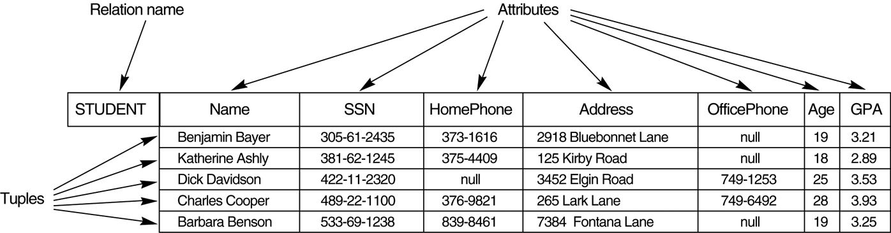
Relational Model
Eg: Student (Name: string, SSN: varchar, HomePhone: varchar,..) Rel^{n} Schema
Rel^{n} Instance
Jagdish Bhatta
Notes:
Jagidsh Bhatta

Slide 6
Domains
A domain D is a set of atomic values. By atomic we mean that each value in the domain is indivisible as far as the formal relational model is concerned. A common method of specifying a domain is to specify a data type from which the data values forming the domain are drawn. It is also useful to specify a name for the domain, to help in interpreting its values.
Data type or format is also specified for each domain.
Some examples of domains follow:
  Names: The set of character strings that represent names of persons.
  Grade_point_averages. Possible values of computed grade point averages; each must be a real (floating-point) number between 0 and 4.
Jagdish Bhatta
Notes:
Jagidsh Bhatta

Slide 7
Attributes
A relation schema R, denoted by R(A1, A2, … , An), is made up of a relation name R and a list of attributes, A1, A2, … , An. Each attribute Ai is the name of a role played by some domain D in the relation schema R. D is called the domain of Ai and is denoted by dom(Ai). A relation schema is used to describe a relation; R is called the name of this relation. The degree (or arity) of a relation is the number of attributes n of its relation schema.
A relation of degree seven, which stores information about university students, would contain seven attributes describing each student as follows:
STUDENT(Name, Ssn, Home_phone, Address, Office_phone, Age, Gpa)
Using the data type of each attribute, the definition is sometimes written as:
STUDENT(Name: string, Ssn: string, Home_phone: string, Address: string, Office_phone: string, Age: integer, Gpa: real)
Jagdish Bhatta
Notes:
Jagidsh Bhatta

Slide 8
Tuples and Relations
Relation (or relation state) r of the relation schema R(A1, A2, … , An), also denoted by r(R), is a set of n-tuples r = {t1, t2, … , tm}. Each n-tuple t is an ordered list of n values t =<v1, v2, … , vn>, where each value vi, 1 ≤ i ≤ n, is an element of dom (Ai) or is a special NULL value.
The ith value in tuple t, which corresponds to the attribute Ai, is referred to as t[Ai] or t.Ai (or t[i] if we use the positional notation). The terms relation intension for the schema R and relation extension for a relation state r(R) are also commonly used.
Figure 5.1 in the next slide shows an example of a STUDENT relation, which corresponds to the STUDENT schema just specified. Each tuple in the relation represents a particular student entity (or object). We display the relation as a table, where each tuple is shown as a row and each attribute corresponds to a column header indicating a role or interpretation of the values in that column. NULL values represent attributes whose values are unknown
or do not exist for some individual STUDENT tuple.
Jagdish Bhatta
Notes:
Jagidsh Bhatta

Slide 9
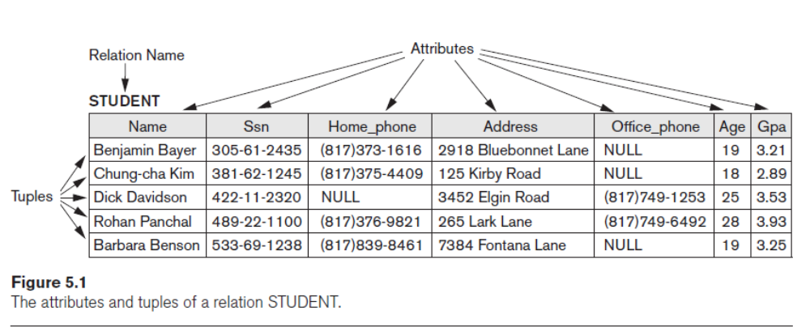
Attributes, Tuples, and Relations
Jagdish Bhatta
Notes:
Jagidsh Bhatta

Slide 10
Relations
The earlier definition of a relation can be restated more formally using set theory concepts as follows. A relation (or relation state) r(R) is a mathematical relation of degree n on the domains dom(A1), dom(A2), … , dom(An), which is a subset of the Cartesian product (denoted by ×) of the domains that define R:
r(R) ⊆ (dom(A1) × dom(A2) × . . . × (dom(An))
The Cartesian product specifies all possible combinations of values from the underlying domains. Hence, if we denote the total number of values, or cardinality, in a domain D by |D| (assuming that all domains are finite), the total number of tuples in the Cartesian product is
|dom(A1)| × |dom(A2)| × . . . × |dom(An)|
This product of cardinalities of all domains represents the total number of possible instances or tuples that can ever exist in any relation state r(R). Of all these possible combinations, a relation state at a given time—the current relation state—reflects only the valid tuples that represent a particular state of the real world. In general, as the state of the real world changes, so does the relation state, by being transformed into another relation state. However, the schema R is relatively static and changes very infrequently—for example, as a result of adding an attribute to represent new information that was not originally stored in the relation.
Jagdish Bhatta
Notes:
Jagidsh Bhatta

Slide 11
Characteristics of relations:
Ordering of Tuples in a Relation: A relation is defined as a set of tuples. Mathematically, elements of a set have no order among them; hence, tuples in a relation do not have any particular order. In other words, a relation is not sensitive to the ordering of tuples. However, in a file, records are physically stored on disk (or in memory), so there always is an order among the records. This ordering indicates first, second, ith, and last records in the file. Similarly, when we display a relation as a table, the rows are displayed in a certain order. Tuple ordering is not part of a relation definition because a relation attempts to represent facts at a logical or abstract level.
Ordering of Values within a Tuple and an Alternative Definition of a Relation: A relation schema R = {A1, A2, … , An} is a set of attributes (instead of an ordered list of attributes), and a relation state r(R) is a finite set of mappings r = {t1, t2, … , tm}, where each tuple ti is a mapping from R to D, and D is the union (denoted by ∪) of the attribute domains; that is, D =dom(A1) ∪ dom(A2) ∪ … ∪ dom(An). In this definition, t[Ai] must be in dom(Ai) for 1 ≤ i ≤ n for each mapping t in r. Each mapping ti is called a tuple. According to this definition of tuple as a mapping, a tuple can be considered as a set of (<attribute>, <value>) pairs, where each pair gives the value of the mapping from an attribute Ai to a value vi from dom(Ai).
Jagdish Bhatta
Notes:
Jagidsh Bhatta

Slide 12
Characteristics of relations:
Values and NULLs in the Tuples: Each value in a tuple is an atomic value; that is, it is not divisible into components within the framework of the basic relational model. Hence, composite and multivalued attributes are not allowed. An important concept is that of NULL values, which are used to represent the values of attributes that may be unknown or may not apply to a tuple. A special value, called NULL, is used in these cases. In general, we can have several meanings for NULL values, such as value unknown, value exists but is not available, or attribute does not apply to this tuple (also known as value undefined).
Interpretation (Meaning) of a Relation. The relation schema can be interpreted as a declaration or a type of assertion. For example, the schema of the STUDENT relation of Figure 5.1, in slide number 9, asserts that, in general, a student entity has a Name, Ssn, Home_phone, Address, Office_phone, Age, and Gpa. Each tuple in the relation can then be interpreted as a fact or a particular instance of the assertion. For example, the first tuple in Figure 5.1 asserts the fact that there is a STUDENT whose Name is Benjamin Bayer, Ssn is 305-61-2435, Age is 19, and so on. An alternative interpretation of a relation schema is as a predicate; in this case, the values in each tuple are interpreted as values that satisfy the predicate. For example, the predicate STUDENT (Name, Ssn, …) is true for the five tuples in relation STUDENT of Figure 5.1.
Jagdish Bhatta
Notes:
Jagidsh Bhatta

Slide 13
Relational Model Notations
A relation schema R of degree n is denoted by R(A1, A2, … , An).
The uppercase letters Q, R, S denote relation names.
The lowercase letters q, r, s denote relation states.
The letters t, u, v denote tuples.
In general, the name of a relation schema such as STUDENT also indicates the current set of tuples in that relation—the current relation state—whereas STUDENT(Name, Ssn, …) refers only to the relation schema.
An attribute A can be qualified with the relation name R to which it belongs by using the dot notation R.A—for example, STUDENT.Name or STUDENT.Age. This is because the same name may be used for two attributes in different relations. However, all attribute names in a particular relation must be distinct.
Jagdish Bhatta
Notes:
Jagidsh Bhatta

Slide 14
Relational Model Notations
An n-tuple t in a relation r(R) is denoted by t = <v1, v2, … , vn>, where vi is the value corresponding to attribute Ai. The following notation refers to component values of tuples:
  Both t[Ai] and t.Ai (and sometimes t[i]) refer to the value vi in t for attribute Ai.
  Both t[Au, Aw, … , Az] and t.(Au, Aw, … , Az), where Au, Aw, … , Az is a list of attributes from R, refer to the subtuple of values <vu, vw, … , vz> from t corresponding to the attributes specified in the list.
As an example, consider the tuple t = <’Barbara Benson’, ‘533-69-1238’, ‘(817)839-8461’, ‘7384 Fontana Lane’, NULL, 19, 3.25> from the STUDENT relation in Figure 5.1, in slide number 9; we have t[Name] = <‘Barbara Benson’>, and t[Ssn, Gpa, Age] = <‘533-69-1238’, 3.25, 19>.
Jagdish Bhatta
Notes:
Jagidsh Bhatta

Slide 15
Relational Model Constraints
There are generally many restrictions or constraints on the actual values in a database state.
Constraints on databases can generally be divided into three main categories:
  Constraints that are inherent in the data model. We call these inherent model-based constraints or implicit constraints.
  Constraints that can be directly expressed in the schemas of the data model, typically by specifying them in the DDL. We call these schema-based constraints or explicit constraints.
  Constraints that cannot be directly expressed in the schemas of the data model, and hence must be expressed and enforced by the application programs or in some other way. We call these application-based or semantic constraints or business rules.
Jagdish Bhatta
Notes:
Jagidsh Bhatta

Slide 16
Relational Model Constraints
There are generally many restrictions or constraints on the actual values in a database state.
Constraints on databases can generally be divided into three main categories:
  Constraints that are inherent in the data model. We call these inherent model-based constraints or implicit constraints.
  Constraints that can be directly expressed in the schemas of the data model, typically by specifying them in the DDL. We call these schema-based constraints or explicit constraints.
  Constraints that cannot be directly expressed in the schemas of the data model, and hence must be expressed and enforced by the application programs or in some other way. We call these application-based or semantic constraints or business rules.
Jagdish Bhatta
Notes:
Jagidsh Bhatta

Slide 17
Relational Model Constraints
The schema-based constraints include domain constraints, key constraints, constraints on NULLs, entity integrity constraints, and referential integrity constraints.
Domain Constraints: Domain constraints specify that within each tuple, the value of each attribute A must be an atomic value from the domain dom(A). The data types associated with domains typically include standard numeric data types for integers (such as short integer, integer, and long integer) and real numbers (float and double-precision float). Characters, Booleans, fixed-length strings, and variable-length strings are also available, as are date, time, timestamp, and other special data types. Domains can also be described by a subrange of values from a data type or as an enumerated data type in which all possible values are explicitly listed.
Jagdish Bhatta
Notes:
Jagidsh Bhatta

Slide 18
Relational Model Constraints
Key Constraints and Constraints on NULL Values: In the formal relational model, a relation is defined as a set of tuples. By definition, all elements of a set are distinct; hence, all tuples in a relation must also be distinct.
This means that no two tuples can have the same combination of values for all their attributes. Usually, there are other subsets of attributes of a relation schema R with the property that no two tuples in any relation state r of R should have the same combination of values for these attributes. Suppose that we denote one such subset of attributes by SK; then for any two distinct tuples t1 and t2 in a relation state r of R, we have the constraint that:
t1[SK] ≠ t2[SK].
Jagdish Bhatta
Notes:
Jagidsh Bhatta

Slide 19
Relational Model Constraints
Any such set of attributes SK is called a superkey of the relation schema R. A superkey SK specifies a uniqueness constraint that no two distinct tuples in any state r of R can have the same value for SK. Every relation has at least one default superkey— the set of all its attributes. A superkey can have redundant attributes, however, so a more useful concept is that of a key, which has no redundancy. A key k of a relation schema R is a superkey of R with the additional property that removing any attribute A from K leaves a set of attributes K′ that is not a superkey of R any more. Hence, a key satisfies two properties:
  Two distinct tuples in any state of the relation cannot have identical values for (all) the attributes in the key. This uniqueness property also applies to a superkey.
  It is a minimal superkey—that is, a superkey from which we cannot remove any attributes and still have the uniqueness constraint hold. This minimality property is required for a key but is optional for a superkey.
Jagdish Bhatta
Notes:
Jagidsh Bhatta

Slide 20
Relational Model Constraints
Any such set of attributes SK is called a superkey of the relation schema R. A superkey SK specifies a uniqueness constraint that no two distinct tuples in any state r of R can have the same value for SK. Every relation has at least one default superkey— the set of all its attributes. A superkey can have redundant attributes, however, so a more useful concept is that of a key, which has no redundancy. A key k of a relation schema R is a superkey of R with the additional property that removing any attribute A from K leaves a set of attributes K′ that is not a superkey of R any more. Hence, a key satisfies two properties:
  Two distinct tuples in any state of the relation cannot have identical values for (all) the attributes in the key. This uniqueness property also applies to a superkey.
  It is a minimal superkey—that is, a superkey from which we cannot remove any attributes and still have the uniqueness constraint hold. This minimality property is required for a key but is optional for a superkey.
Jagdish Bhatta
Notes:
Jagidsh Bhatta

Slide 21
Relational Model Constraints
Hence, a key is a superkey but not vice versa. A superkey may be a key (if it is minimal) or may not be a key (if it is not minimal). Consider the STUDENT relation of Figure 5.1, in slide number 9. The attribute set {Ssn} is a key of STUDENT because no two student tuples can have the same value for Ssn.8 Any set of attributes that includes Ssn—for example, {Ssn, Name, Age}—is a superkey. However, the superkey {Ssn, Name, Age} is not a key of STUDENT because removing Name or Age or both from the set still leaves us with a superkey. In general, any superkey formed from a single attribute is also a key. A key with multiple attributes must require all its attributes together to have the uniqueness property.
Jagdish Bhatta
Notes:
Jagidsh Bhatta

Slide 22
Relational Model Constraints
The value of a key attribute can be used to identify uniquely each tuple in the relation.
Notice that a set of attributes constituting a key is a property of the relation schema; it is a constraint that should hold on every valid relation state of the schema.
A key is determined from the meaning of the attributes, and the property is time-invariant: It must continue to hold when we insert new tuples in the relation. For example, we cannot and should not designate the Name attribute of the STUDENT relation in Figure 5.1 as a key because it is possible that two students with identical names will exist at some point in a valid state.
Jagdish Bhatta
Notes:
Jagidsh Bhatta

Slide 23
Relational Model Constraints
In general, a relation schema may have more than one key. In this case, each of the keys is called a candidate key. For example, the CAR relation in Figure 5.4, in slide number 23, has two candidate keys: License_number and Engine_serial_number. It is common to designate one of the candidate keys as the primary key of the relation. This is the candidate key whose values are used to identify tuples in the relation.
The convention that the attributes that form the primary key of a relation schema are underlined is followed in general.
When a relation schema has several candidate keys, the choice of one to become the primary key is somewhat arbitrary; however, it is usually better to choose a primary key with a single attribute or a small number of attributes. The other candidate keys are designated as unique keys and are not underlined
Jagdish Bhatta
Notes:
Jagidsh Bhatta

Slide 24
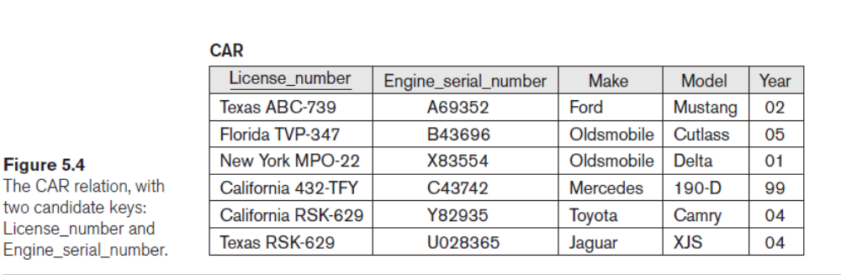
Relational Model Constraints
Jagdish Bhatta
Notes:
Jagidsh Bhatta

Slide 25
Relational Model Constraints
Another constraint on attributes specifies whether NULL values are or are not permitted.
For example, if every STUDENT tuple must have a valid, non-NULL value for the Name attribute, then Name of STUDENT is constrained to be NOT NULL.
Jagdish Bhatta
Notes:
Jagidsh Bhatta

Slide 26
Relational Databases and Relational Database Schemas
A relational database schema S is a set of relation schemas S = {R1, R2, … , Rm} and a set of integrity constraints IC. A relational database state DB of S is a set of relation states DB = {r1, r2, … , rm} such that each ri is a state of Ri and such that the ri relation states satisfy the integrity constraints specified. Figure 5.5, in slide number 27, shows a relational database schema that we call COMPANY = {EMPLOYEE, DEPARTMENT, DEPT_LOCATIONS, PROJECT, WORKS_ON, DEPENDENT}. In each relation schema, the underlined attribute represents the primary key. The figure 5.6 shows a relational database state corresponding to the COMPANY schema.
When we refer to a relational database, we implicitly include both its schema and its current state. A database state that does not obey all the integrity constraints is called not valid, and a state that satisfies all the constraints in the defined set of integrity constraints is called a valid state.
Jagdish Bhatta
Notes:
Jagidsh Bhatta

Slide 27
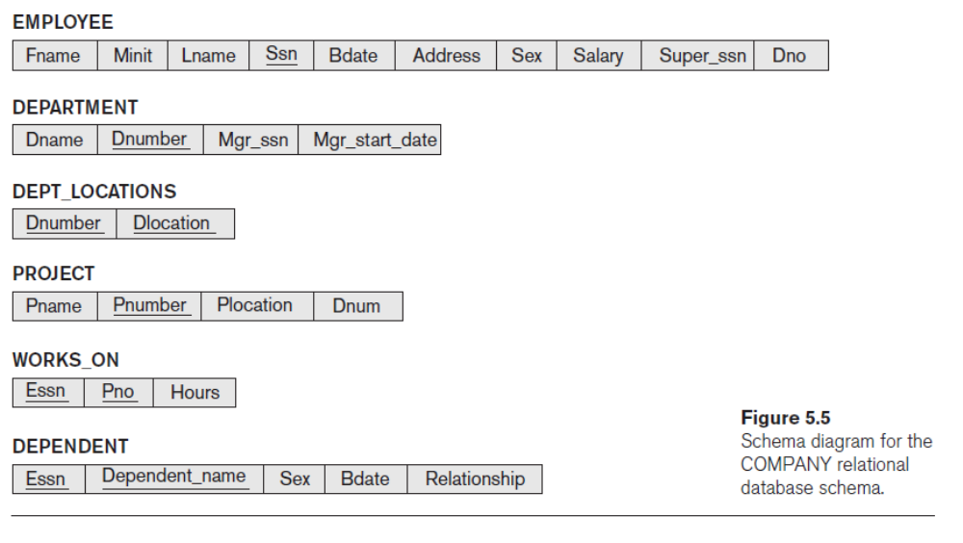
Relational Databases and Relational Database Schemas
Jagdish Bhatta
Notes:
Jagidsh Bhatta

Slide 28
Relational Databases and Relational Database Schemas
In some early versions of the relational model, an assumption was made that the same real-world concept, when represented by an attribute, would have identical attribute names in all relations. This creates problems when the same real-world concept is used in different roles (meanings) in the same relation. For example, the concept of Social Security number appears twice in the EMPLOYEE relation of Figure 5.5, in previous slide: once in the role of the employee’s SSN, and once in the role of the supervisor’s SSN. We are required to give them distinct attribute names—Ssn and Super_ssn, respectively—because they appear in the same relation and in order to distinguish their meaning.
Jagdish Bhatta
Notes:
Jagidsh Bhatta

Slide 29
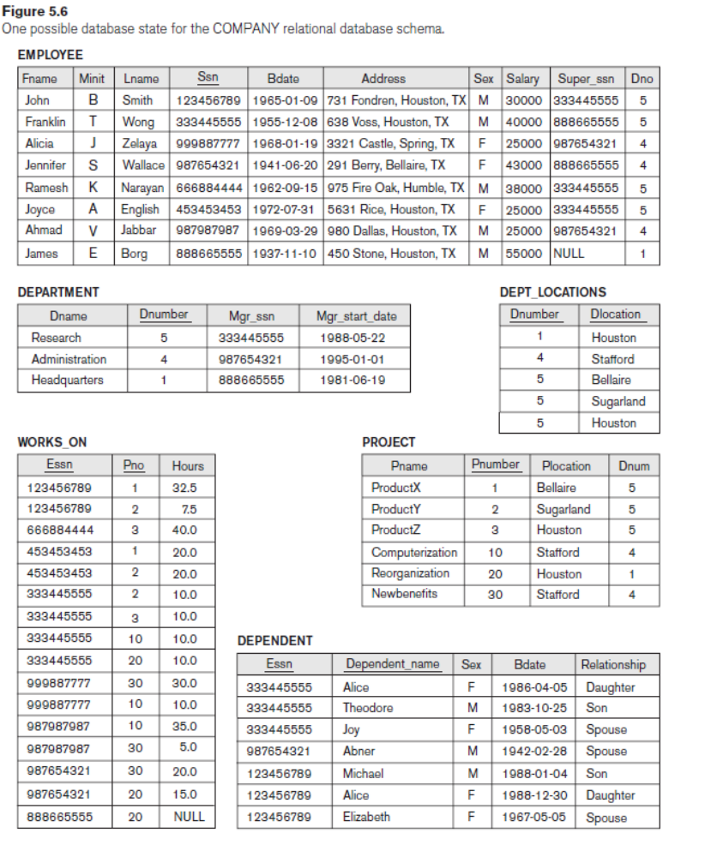
Relational Databases and Relational Database Schemas
Jagdish Bhatta
Notes:
Jagidsh Bhatta

Slide 30
Entity Integrity, Referential Integrity, and Foreign Keys
The entity integrity constraint states that no primary key value can be NULL. This is because the primary key value is used to identify individual tuples in a relation. Having NULL values for the primary key implies that we cannot identify some tuples. For example, if two or more tuples had NULL for their primary keys, we may not be able to distinguish them if we try to reference them from other relations.
Key constraints and entity integrity constraints are specified on individual relations. The referential integrity constraint is specified between two relations and is used to maintain the consistency among tuples in the two relations. Informally, the referential integrity constraint states that a tuple in one relation that refers to another relation must refer to an existing tuple in that relation. For example, in Figure 5.6, in the previous slide, the attribute Dno of EMPLOYEE gives the department number for which each employee works; hence, its value in every EMPLOYEE tuple must match the Dnumber value of some tuple in the DEPARTMENT relation.
Jagdish Bhatta
Notes:
Jagidsh Bhatta

Slide 31
Entity Integrity, Referential Integrity, and Foreign Keys
To define referential integrity more formally, first we define the concept of a foreign key. The conditions for a foreign key, given below, specify a referential integrity constraint between the two relation schemas R1 and R2. A set of attributes FK in relation schema R1 is a foreign key of R1 that references relation R2 if it satisfies the following rules:
  The attributes in FK have the same domain(s) as the primary key attributes PK of R2; the attributes FK are said to reference or refer to the relation R2.
  A value of FK in a tuple t1 of the current state r1(R1) either occurs as a value of PK for some tuple t2 in the current state r2(R2) or is NULL. In the former case, we have t1[FK] = t2[PK], and we say that the tuple t1 references or refers to the tuple t2.
In this definition, R1 is called the referencing relation and R2 is the referenced relation. If these two conditions hold, a referential integrity constraint from R1 to R2 is said to hold. In a database of many relations, there are usually many referential integrity constraints.
Jagdish Bhatta
Notes:
Jagidsh Bhatta

Slide 32
Entity Integrity, Referential Integrity, and Foreign Keys
Referential integrity constraints typically arise from the relationships among the entities represented by the relation schemas. For example, consider the database shown in Figure 5.6, slide number 29. In the EMPLOYEE relation, the attribute Dno refers to the department for which an employee works; hence, we designate Dno to be a foreign key of EMPLOYEE referencing the DEPARTMENT relation. This means that a value of Dno in any tuple t1 of the EMPLOYEE relation must match a value of the primary key of DEPARTMENT—the Dnumber attribute—in some tuple t2 of the DEPARTMENT relation, or the value of Dno can be NULL if the employee does not belong to a department or will be assigned to a department later. For example, in Figure 5.6, in slide number 29, the tuple for employee ‘John Smith’ references the tuple for the ‘Research’ department, indicating that ‘John Smith’ works for this department.
Jagdish Bhatta
Notes:
Jagidsh Bhatta

Slide 33
Entity Integrity, Referential Integrity, and Foreign Keys
Notice that a foreign key can refer to its own relation. For example, the attribute Super_ssn in EMPLOYEE refers to the supervisor of an employee; this is another employee, represented by a tuple in the EMPLOYEE relation. Hence, Super_ssn is a foreign key that references the EMPLOYEE relation itself. In Figure 5.6, in the slide number 29, the tuple for employee ‘John Smith’ references the tuple for employee ‘Franklin Wong,’ indicating that ‘Franklin Wong’ is the supervisor of ‘John Smith’.
We can diagrammatically display referential integrity constraints by drawing a directed arc from each foreign key to the relation it references. For clarity, the arrowhead may point to the primary key of the referenced relation. Figure 5.7, in next slide, shows the schema in Figure 5.5, in slide number 27, with the referential integrity constraints displayed in this manner.
Jagdish Bhatta
Notes:
Jagidsh Bhatta

Slide 34
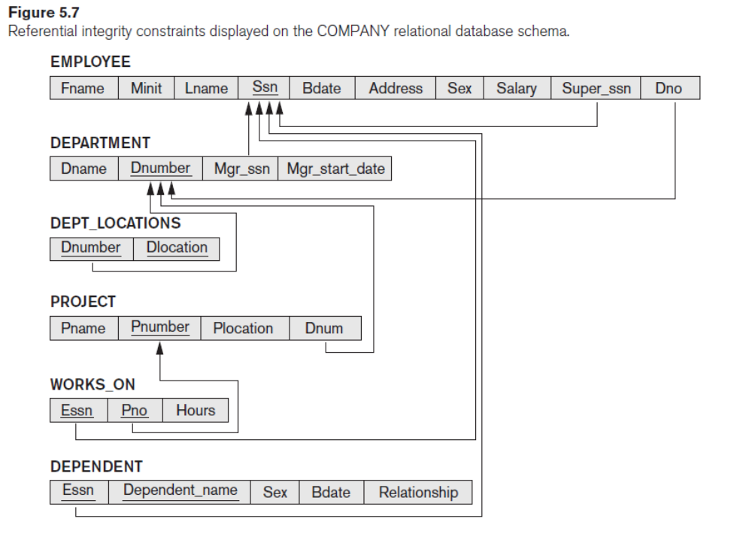
Entity Integrity, Referential Integrity, and Foreign Keys
Jagdish Bhatta
Notes:
Jagidsh Bhatta

Slide 35
Entity Integrity, Referential Integrity, and Foreign Keys
All integrity constraints should be specified on the relational database schema (that is, specified as part of its definition) if we want the DBMS to enforce these constraints on the database states. Hence, the DDL includes provisions for specifying the various types of constraints so that the DBMS can automatically enforce them.
In SQL, the CREATE TABLE statement of the SQL DDL allows the definition of primary key, unique key, NOT NULL, entity integrity, and referential integrity constraints, among other constraints
Jagdish Bhatta
Notes:
Jagidsh Bhatta

Slide 36
Other Types of Constraints
The preceding integrity constraints are included in the data definition language because they occur in most database applications. Another class of general constraints, sometimes called semantic integrity constraints, are not part of the DDL and have to be specified and enforced in a different way. Examples of such constraints are the salary of an employee should not exceed the salary of the employee’s supervisor and the maximum number of hours an employee can work on all projects per week is 56. Such constraints can be specified and enforced within the application programs that update the database, or by using a general-purpose constraint specification language. Mechanisms called triggers and assertions can be used in SQL, through the CREATE ASSERTION and CREATE TRIGGER statements, to specify some of these constraints. It is more common to check for these types of constraints within the application programs than to use constraint specification languages because the latter are sometimes difficult and complex to use.
Jagdish Bhatta
Notes:
Jagidsh Bhatta

Slide 37
Other Types of Constraints
The types of constraints we discussed so far may be called state constraints because they define the constraints that a valid state of the database must satisfy.
Another type of constraint, called transition constraints, can be defined to deal with state changes in the database. An example of a transition constraint is: “the salary of an employee can only increase.” Such constraints are typically enforced by the application programs or specified using active rules and triggers.
Jagdish Bhatta
Notes:
Jagidsh Bhatta

Slide 38
Database Modification and Dealing with Constraint Violations
There are three basic operations that can change the states of relations in the database: Insert, Delete, and Update (or Modify). They insert new data, delete old data, or modify existing data records, respectively.
Insert is used to insert one or more new tuples in a relation.
Delete is used to delete tuples.
Update (or Modify) is used to change the values of some attributes in existing tuples.
Whenever these operations are applied, the integrity constraints specified on the relational database schema should not be violated.
Jagdish Bhatta
Notes:
Jagidsh Bhatta

Slide 39
Database Modification and Dealing with Constraint Violations
The Insert Operation:
The Insert operation provides a list of attribute values for a new tuple t that is to be inserted into a relation R. Insert can violate any of the four types of constraints.
  Domain constraints can be violated if an attribute value is given that does not appear in the corresponding domain or is not of the appropriate data type.
  Key constraints can be violated if a key value in the new tuple t already exists in another tuple in the relation r(R).
  Entity integrity can be violated if any part of the primary key of the new tuple t is NULL. Referential integrity can be violated if the value of any foreign key in t refers to a tuple that does not exist in the referenced relation.
Jagdish Bhatta
Notes:
Jagidsh Bhatta

Slide 40
Database Modification and Dealing with Constraint Violations
The Insert Operation:
If an insertion violates one or more constraints, the default option is to reject the insertion. In this case, it would be useful if the DBMS could provide a reason to the user as to why the insertion was rejected.
Jagdish Bhatta
Notes:
Jagidsh Bhatta

Slide 41
Database Modification and Dealing with Constraint Violations
The Delete Operation:
The Delete operation can violate only referential integrity. This occurs if the tuple being deleted is referenced by foreign keys from other tuples in the database. To specify deletion, a condition on the attributes of the relation selects the tuple (or tuples) to be deleted.
Several options are available if a deletion operation causes a violation. The first option, called restrict, is to reject the deletion. The second option, called cascade, is to attempt to cascade (or propagate) the deletion by deleting tuples that reference the tuple that is being deleted. A third option, called set null or set default, is to modify the referencing attribute values that cause the violation; each such value is either set to NULL or changed to reference another default valid tuple. Notice that if a referencing attribute that causes a violation is part of the primary key, it cannot be set to NULL; otherwise, it would violate entity integrity.
Jagdish Bhatta
Notes:
Jagidsh Bhatta

Slide 42
Database Modification and Dealing with Constraint Violations
The Update Operation:
The Update (or Modify) operation is used to change the values of one or more attributes in a tuple (or tuples) of some relation R. It is necessary to specify a condition on the attributes of the relation to select the tuple (or tuples) to be modified.
Updating an attribute that is neither part of a primary key nor part of a foreign key usually causes no problems; the DBMS need only check to confirm that the new value is of the correct data type and domain. Modifying a primary key value is similar to deleting one tuple and inserting another in its place because we use the primary key to identify tuples. Hence, the issues discussed earlier for Insert and Delete come into play.
Jagdish Bhatta
Notes:
Jagidsh Bhatta

Slide 43
Relational Database Design Using ER-to-Relational Mapping
It includes how to design a relational database schema based on a conceptual schema design. Here, we focus on the logical database design step of database design, which is also known as data model mapping. We present the procedures to create a relational schema from an entity–relationship (ER).
It includes a seven-step algorithm to convert the basic ER model constructs—entity types (strong and weak), binary relationships (with various structural constraints), n-ary relationships, and attributes (simple, composite, and multivalued)—into relations
Jagdish Bhatta
Jagdish Bhatta
Notes:
Jagidsh Bhatta
Jagidsh Bhatta

Slide 44
Reduction of E-R Schema to Tables
As a part of database design, representing the logical structure of database with the relational tables needs conversion of the conceptual ER-representation into the tables. This conversion is the mapping of ER-schema into the tables.
Reduction of E-R schema into tables include following algorithmic steps:
Step 1: Mapping of Regular Entity Types
Step 2: Mapping of Weak Entity Types
Step 3: Mapping of Binary 1:1 Relation Types
Step 4: Mapping of Binary 1:N Relationship Types.
Step 5: Mapping of Binary M:N Relationship Types.
Step 6: Mapping of Multivalued attributes.
Step 7: Mapping of N-ary Relationship Types.
Jagdish Bhatta
Jagdish Bhatta
Notes:
Jagidsh Bhatta
Jagidsh Bhatta

Slide 45

ER to Relational Mapping: An Example
Jagdish Bhatta
Jagdish Bhatta
Notes:
Jagidsh Bhatta
Jagidsh Bhatta

Slide 46
Step1: Mapping of Regular Entity Types:
For each regular (strong) entity type E in the ER schema, create a relation R that includes all the simple attributes of E.
Include only simple component attributes of a composite attribute.
Choose one of the key attributes of E as the primary key for R. If the chosen key of E is composite, the set of simple attributes that form it will together form the primary key of R.
Jagdish Bhatta
Jagdish Bhatta
Notes:
Jagidsh Bhatta
Jagidsh Bhatta

Slide 47
Step2: Mapping of Weak Entity Types:
For each weak entity type W in the ER schema with owner entity type E, create a relation R and include all simple attributes (or simple components of composite attributes) of W as attributes of R.
In addition, include as foreign key attributes of R the primary key attribute(s) of the relation(s) that correspond to the owner entity type(s).
The primary key of R is the combination of the primary key(s) of the owner(s) and the partial key of the weak entity type W, if any. If there is a weak entity type E2 whose owner is also a weak entity type E1, then E1 should be mapped before E2 to determine its primary key first.
Jagdish Bhatta
Jagdish Bhatta
Notes:
Jagidsh Bhatta
Jagidsh Bhatta

Slide 48
Step3: Mapping of binary 1:1 Relationship Types:
For each binary 1:1 relationship type R in the ER schema, identify the relations S and T that correspond to the entity types participating in R. There are three possible approaches:
(1) Foreign Key approach: Choose one of the relations, say, S and include the primary key of T as a foreign key in S. To choose role of S, it is better to choose an entity type with total participation in the relationship R. Include attributes of the relationship type, if any, as attributes of S. This approach is the most useful and should be followed unless special conditions exist.
  Example: 1:1 relation MANAGES is mapped by choosing the participating entity type DEPARTMENT to serve in the role of S, because its participation in the MANAGES relationship type is total. We include the primary key of the EMPLOYEE relation as foreign key in the DEPARTMENT relation and rename it to Mgr_ssn. We also include the simple attribute Start_date of the MANAGES relationship type in the DEPARTMENT relation and rename it Mgr_start_date
Jagdish Bhatta
Jagdish Bhatta
Notes:
Jagidsh Bhatta
Jagidsh Bhatta

Slide 49
Step3: Mapping of binary 1:1 Relationship Types:
(2) Merged relation option: An alternate mapping of a 1:1 relationship type is possible by merging the two entity types and the relationship into a single relation. This may be appropriate when both participations are total.
(3) Cross-reference or relationship relation option: The third alternative is to set up a third relation R for the purpose of cross-referencing the primary keys of the two relations S and T representing the entity types. As we will see, this approach is required for binary M:N relationships. The relation R is called a relationship relation (or sometimes a lookup table), because each tuple in R represents a relationship instance that relates one tuple from S with one tuple from T. The relation R will include the primary key attributes of S and T as foreign keys to S and T. The primary key of R will be one of the two foreign keys, and the other foreign key will be a unique key of R. The drawback is having an extra relation, and requiring extra join operations when combining related tuples from the tables.
Jagdish Bhatta
Jagdish Bhatta
Notes:
Jagidsh Bhatta
Jagidsh Bhatta

Slide 50
Step4: Mapping of binary 1:N Relationship Types:
There are two possible approaches: (1) the foreign key approach and (2) the cross-reference or relationship relation approach. The first approach is generally preferred as it reduces the number of tables.
The foreign key approach: For each regular binary 1:N relationship type R, identify the relation S that represents the participating entity type at the N-side of the relationship type. Include as foreign key in S the primary key of the relation T that represents the other entity type participating in R; we do this because each entity instance on the N-side is related to at most one entity instance on the 1-side of the relationship type. Include any simple attributes (or simple components of composite attributes) of the 1:N relationshiptype as attributes of S.
Jagdish Bhatta
Jagdish Bhatta
Notes:
Jagidsh Bhatta
Jagidsh Bhatta

Slide 51
Step4: Mapping of binary 1:N Relationship Types:
The relationship relation approach: An alternative approach is to use the relationship relation (cross-reference) option as in the third option for binary 1:1 relationships. We create a separate relation R whose attributes are the primary keys of S and T, which will also be foreign keys to S and T. The primary key of R is the same as the primary key of S. This option can be used if few tuples in S participate in the relationship to avoid excessive NULL values in the foreign key.
For a 1:N relationship, the primary key of the relationship relation will be the foreign key that references the entity relation on the N-side.
Jagdish Bhatta
Jagdish Bhatta
Notes:
Jagidsh Bhatta
Jagidsh Bhatta

Slide 52
Step5: Mapping of binary M:N Relationship Types:
In the traditional relational model with no multivalued attributes, the only option for M:N relationships is the relationship relation (cross-reference) option. For each binary M:N relationship type R, create a new relation S to represent R. Include as foreign key attributes in S the primary keys of the relations that represent the participating entity types; their combination will form the primary key of S. Also include any simple attributes of the M:N relationship type (or simple components of composite attributes) as attributes of S. Notice that we cannot represent an M:N relationship type by a single foreign key attribute in one of the participating relations (as we did for 1:1 or 1:N relationship types) because of the M:N cardinality ratio; we must create a separate relationship relation S.
Jagdish Bhatta
Jagdish Bhatta
Notes:
Jagidsh Bhatta
Jagidsh Bhatta

Slide 53
Step6: Mapping of Multivalued Attributes:
For each multivalued attribute A, create a new relation R. This relation R will include an attribute corresponding to A, as well as the primary key attribute K of the relation that represents the entity type of relationship type that has A as an attribute as a foreign key in R.
The primary key of R is the combination of A and K. If the multivalued attribute is composite, we include its simple components.
Jagdish Bhatta
Jagdish Bhatta
Notes:
Jagidsh Bhatta
Jagidsh Bhatta

Slide 54
Step7: Mapping of N-ary Relationship Types:
We use the relationship relation option. For each n-ary relationship type R, where n > 2, create a new relationship relation S to represent R. Include as foreign key attributes in S the primary keys of the relations that represent the participating entity types. Also include any simple attributes of the n-ary relationship type (or simple components of composite attributes) as attributes of S. The primary key of S is usually a combination of all the foreign keys that reference the relations representing the participating entity types. However, if the cardinality constraints on any of the entity types E participating in R is 1, then the primary key of S should not include the foreign key attribute that references the relation E′ corresponding to E
Jagdish Bhatta
Jagdish Bhatta
Notes:
Jagidsh Bhatta
Jagidsh Bhatta

Slide 55
ER to Relational Mapping: An Example
Jagdish Bhatta
Jagdish Bhatta
Notes:
Jagidsh Bhatta
Jagidsh Bhatta

Slide 56

ER to Relational Mapping: An Example
Fig: Result of mapping the COMPANY ER schema into a relational schema.
Jagdish Bhatta
Jagdish Bhatta
Notes:
Jagidsh Bhatta
Jagidsh Bhatta

Slide 57

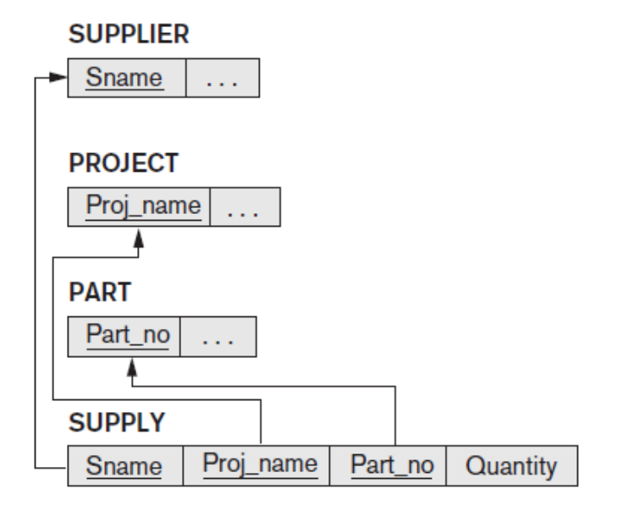
Mapping of N-ary relationship
Fig: A Ternary relationship
Fig: Result of ER to Relational Mapping of the n-ary relationship type
Jagdish Bhatta
Jagdish Bhatta
Notes:
Jagidsh Bhatta
Jagidsh Bhatta

Slide 58
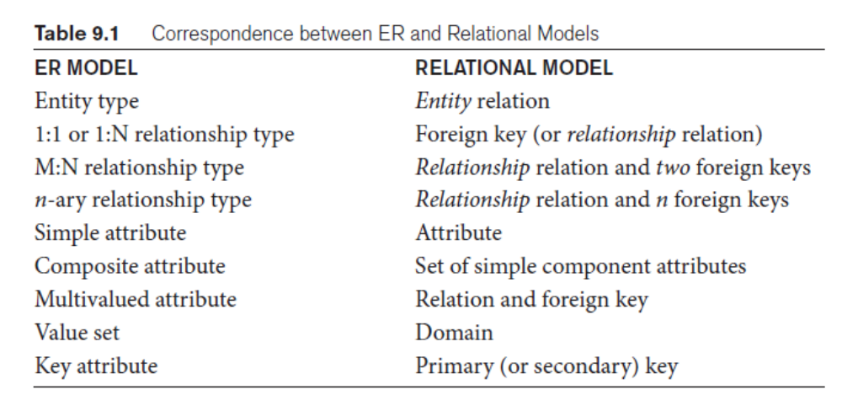
Jagdish Bhatta
Notes:
Jagidsh Bhatta

